Slide 1
Code Club
Cryptography
Week 6

Slide 2
Cryptography
Also known as cryptology;
Comes from Greek κρυπτός, kryptos, "hidden, secret";
and γράφω, gráphō, "I write",
A Study of hiding information (Or coding information)

Slide 3
Cryptography
The method of changing text is called a "code" or, more precisely, a "cipher”

Slide 4
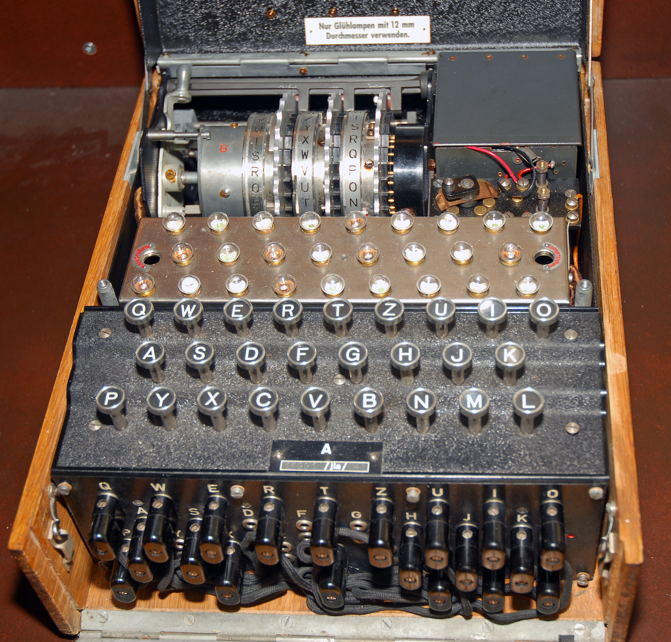
Cryptography in History
ENIGMA
Hide instructions to the Nazi army in the WWII
Encryption broken by the British Alan Turing and his team \o/

Slide 5
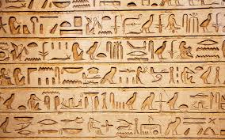
Cryptography in History
Hieroglyphs
When no one is left who knows how to read a language, it becomes a secret code of its own

Slide 6
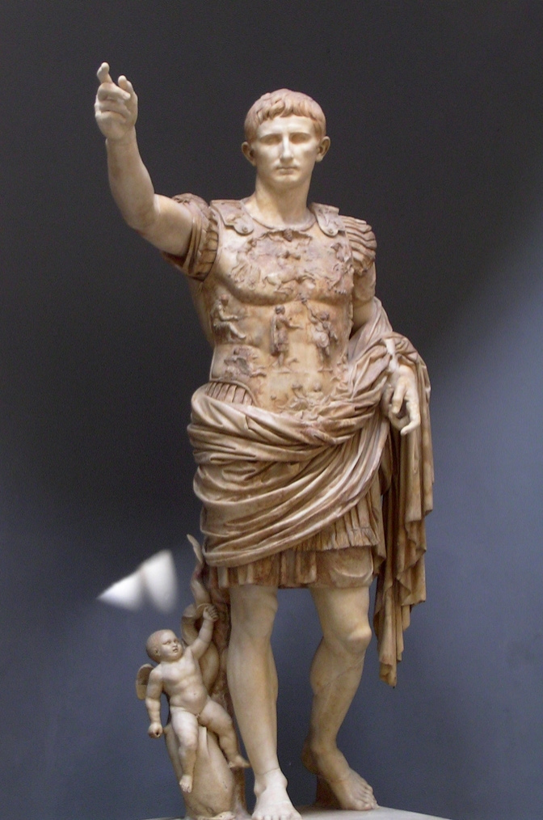
Cryptography in History
Julius Caesar (100 BC)
Invented the Caesar cipher to hide secrets sent to their generals

Slide 7
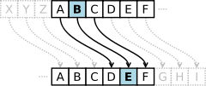
Caesar cipher,
Each letter in the message is changed using a simple rule
change by three:
So each letter is replaced by the letter three letters ahead in the alphabet.

Slide 8
Caesar cipher,
Each letter in the message is changed using a simple rule
change by three:
So each letter is replaced by the letter three letters ahead in the alphabet.

Slide 9
Caesar cipher

Slide 10
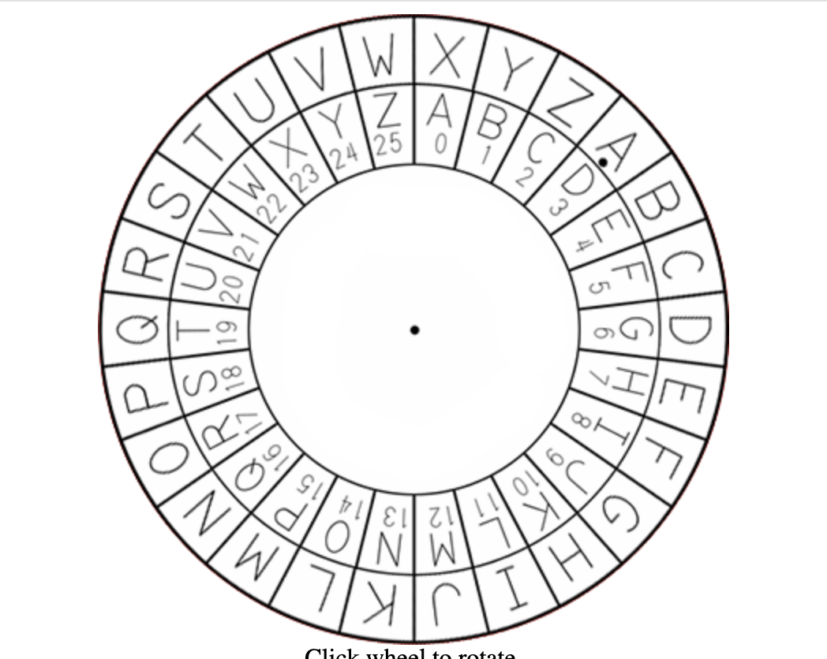
Caesar Wheel
Can you Decode?
JRRG
MRE

Slide 11
Let’s code in Python
bit.ly/CCFULHAM

